Slide 1
Ventura County Geology
With Impacts on Development
By Mike Mishler

Slide 2
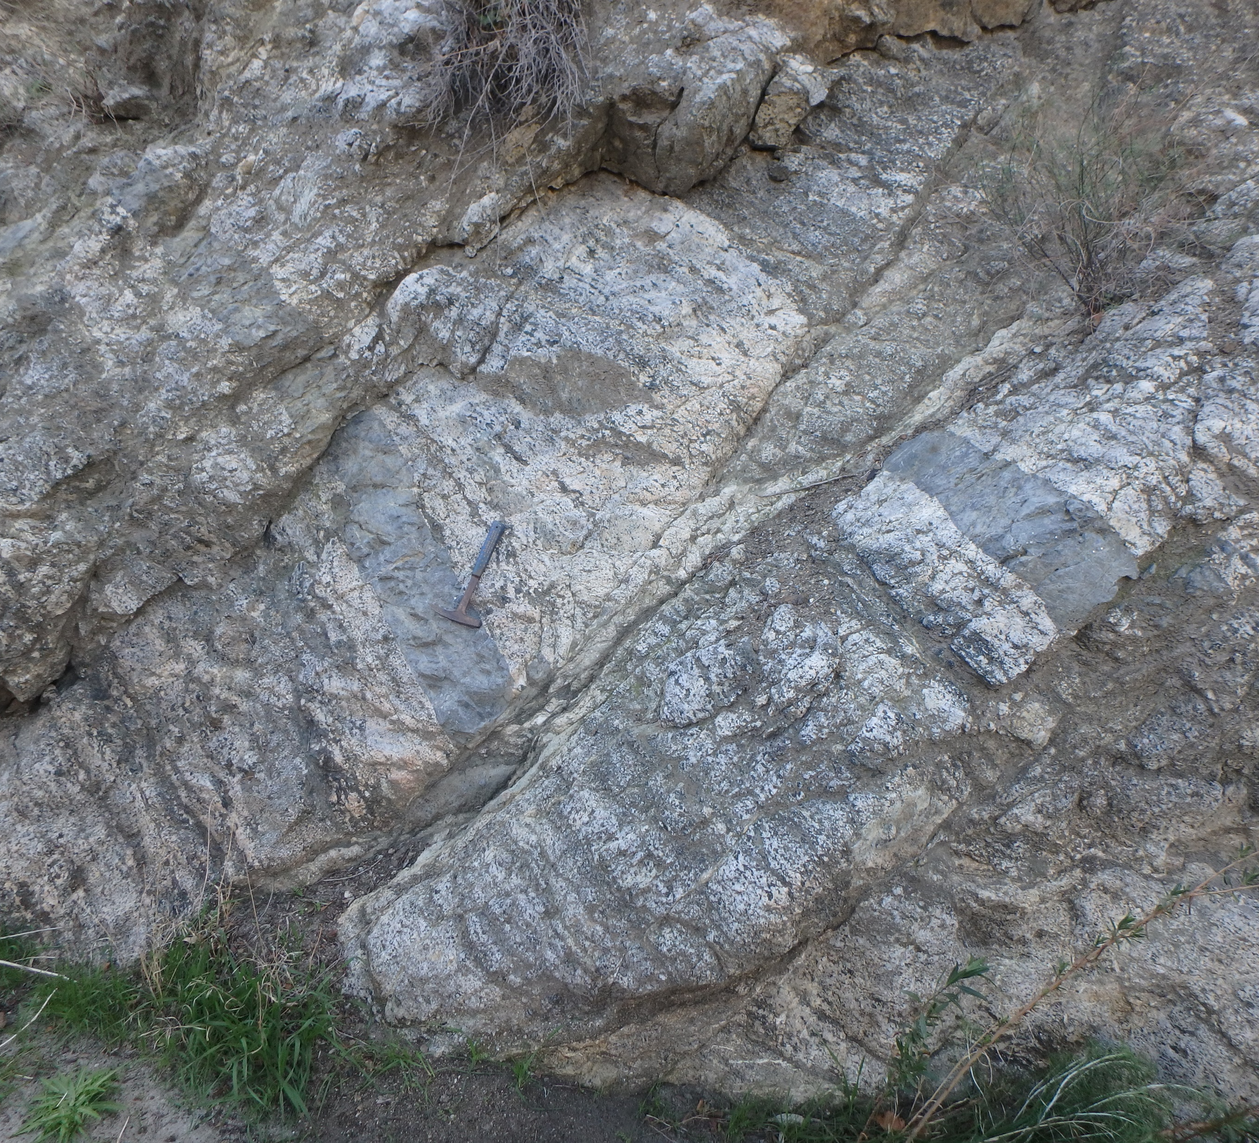
Continental Crust
Outcrop location
Western San Gabriel Mtns
Anorthosite
Plagioclase Feldspar
Ca(Al2 Si2 O8)
Calcium rich
1.2 billion years old
Fun question
See the fault

Slide 3
Fault

Slide 4
Anorthosites
Oldest moon rocks
Lunar highlands
Seen as white areas on moon

Slide 5
Geologic History
Local plate movements
– 20 million years ago to present

Slide 6
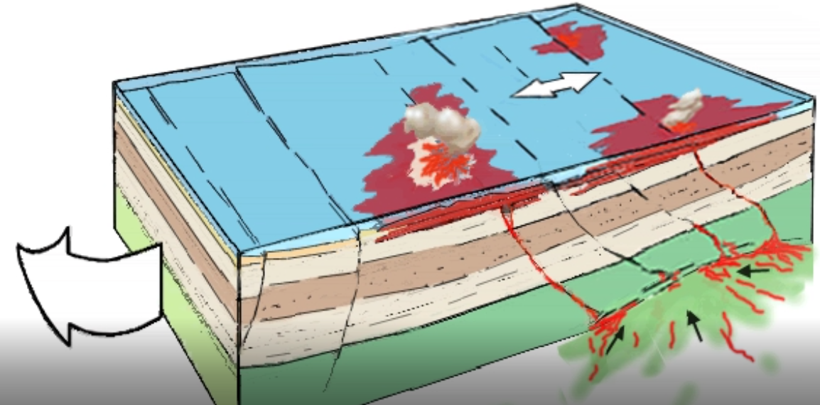
Geologic History
14 million years ago
As sea floor off San Diego starts to pull apart
Allows molten rock to reach sea floor
Volcanic rock flows across sea floor
Conejo Volcanic Formation
Conejo Mtn
Is volcanic vent

Slide 7
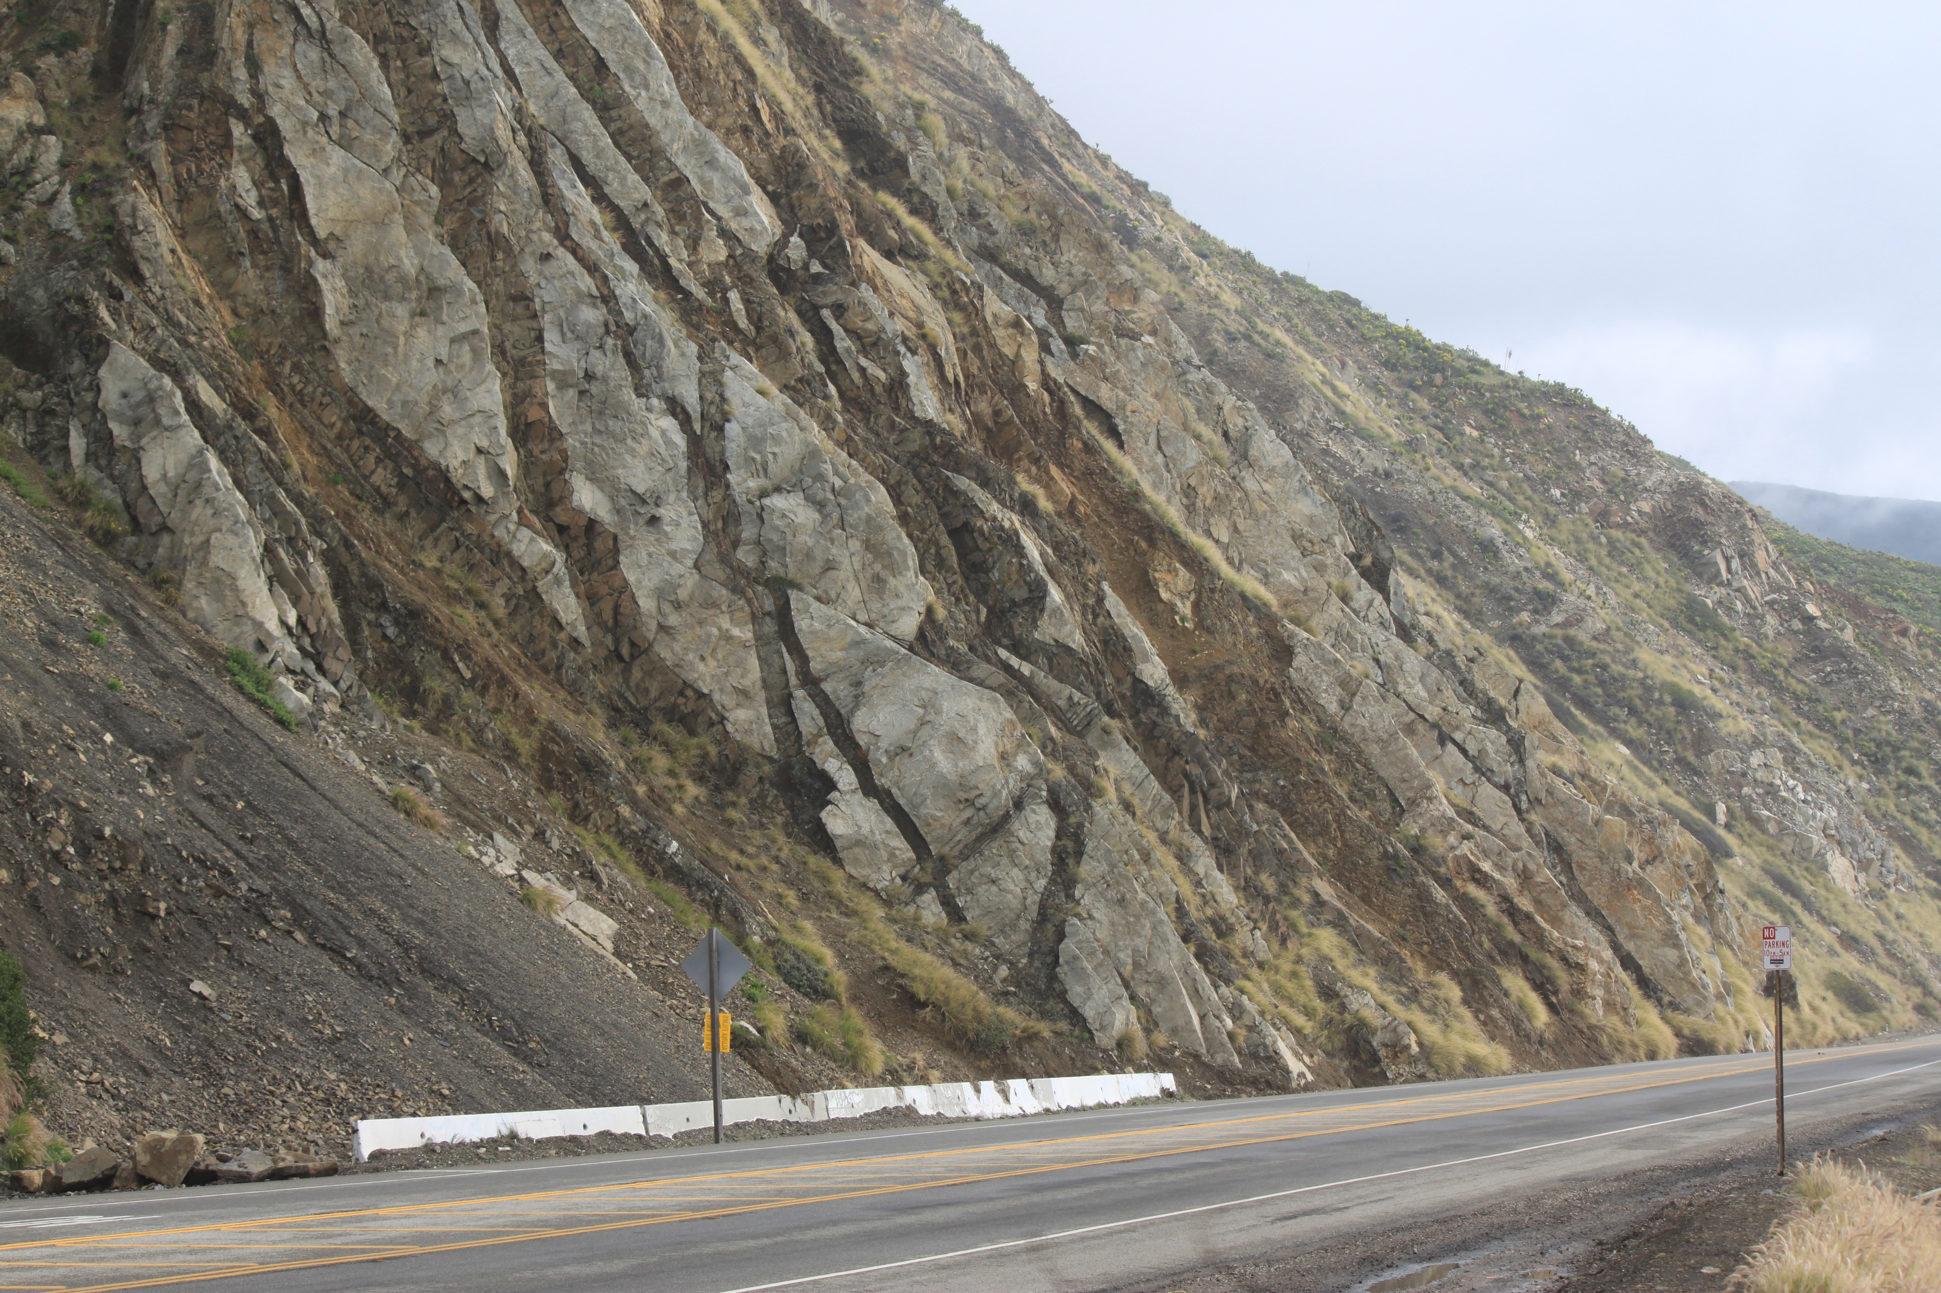
Geologic History
See old sea floor sediments with volcanic dikes
- Just east of Mugu Rock on Hwy 1
Volcanic dikes
cutting through old sediments

Slide 8
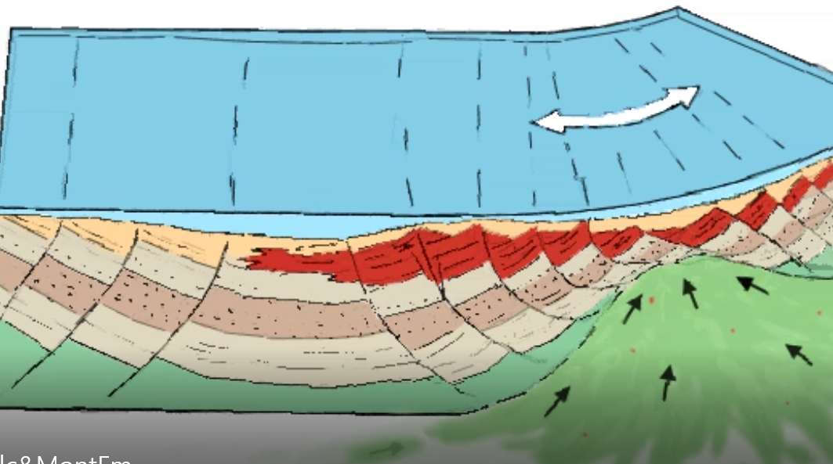
Geologic History
14 to 8 million years ago
Monterey Formation was deposited
Deep water, organic rich ‘shale’
Up to 30% organic matter
Diatoms
Microscopic single cell plants
With silica shells
Up to 3,400 ft thick
covers much of western CA
Main source of CA oil

Slide 9
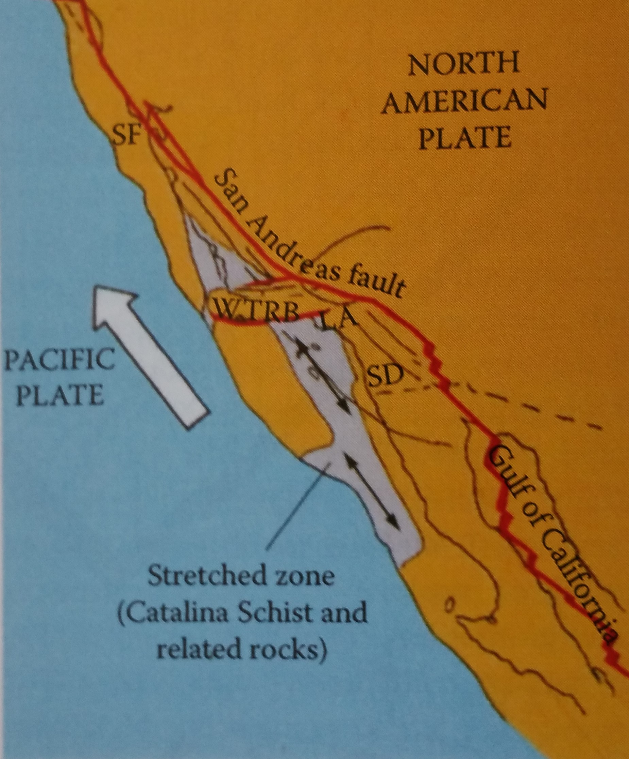
Geologic History
Local plate movements – 20 million years ago thru today
Current
San Andreas fault created 5 million years ago
Bend in San Andreas fault causes compression in Ventura County area
Compression is about 7 to 10 mm (0.28 to 0.4 inches) /year
‘WTRB’ =western Transverse Range block
LA and Ventura Basins filled in with sediments up to 30,000 feet deep

Slide 10
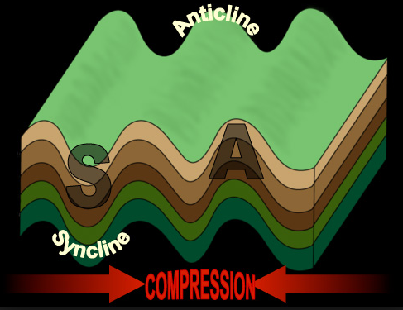
Ventura County compression (past 5 million years)
Bend in Mostly N-S compression orientation – 0.28 to 0.4 inches/year
All types of compression occur in Ventura County
Folding
Faulting
Combined faulting and folding

Slide 11
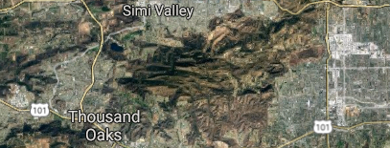
Ventura County compression (past 5 million years)
Santa Monica Mountains
Starting pushing up 5 mya
Was up to 1 mile high
First – the northern range (near Simi Valley)
Malibu Creek and LA River flowing North to South
Malibu Creek LA River

Slide 12
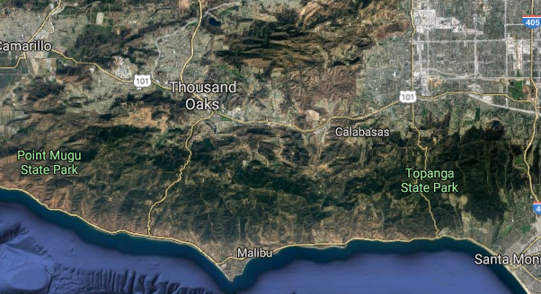
Ventura County compression (past 5 million years)
Santa Monica Mountains
Next the southern range starts pushing up
Malibu Creek cuts thru southern range as it rises
LA River location is pushed east around southern range

Slide 13
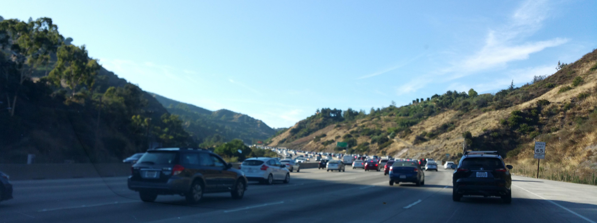
Ventura County compression (past 5 million years)
Santa Monica Mountains
LA River location is pushed east around southern range
Cuts the canyons running across the Santa Monica Mtns
Example – Sepulveda Pass was cut by LA River

Slide 14
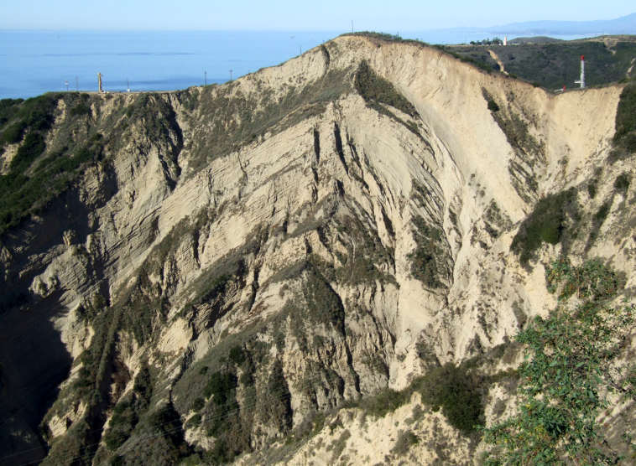
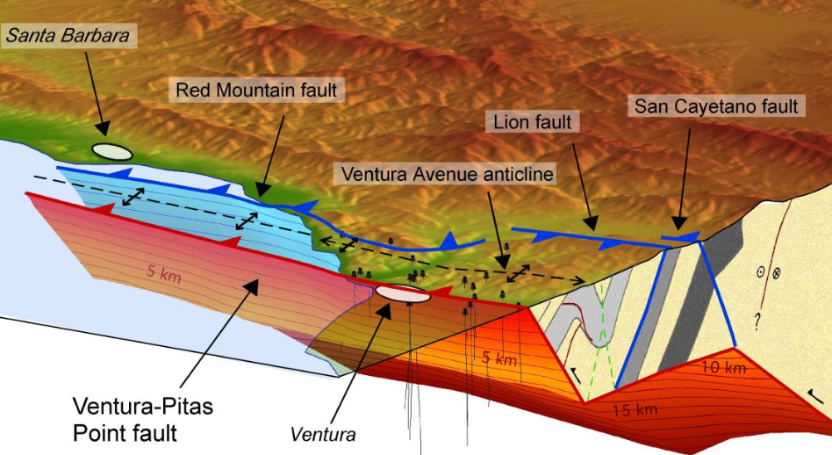
Ventura County compression (past 5 million years)
Ventura Avenue anticline
Rising about 5 mm (0.2 inches) / year

Slide 15
Ventura County compression (past 5 million years)
Northern Ventura County ‘Highlands’
Started pushing up 5 million years ago
Uplifting started in north, then extending to the south
Each new uplift to the south, not as high
Latest uplift starting at south edge of Camarillo City
Highlands
South Mtn
Camarillo Heights
Most recent uplift

Slide 16
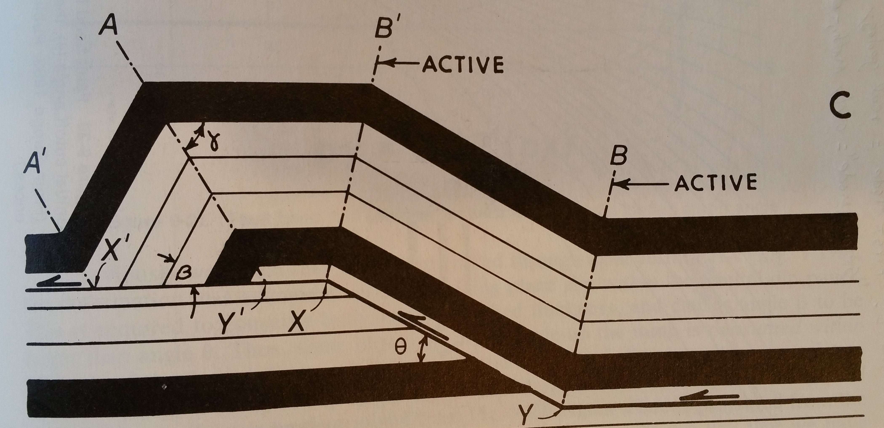
Ventura County compression (past 5 million years)
Faulting mechanisms creating ‘Highlands’
Fault propagation folds
Fault bend fold
South
North
South
North

Slide 17
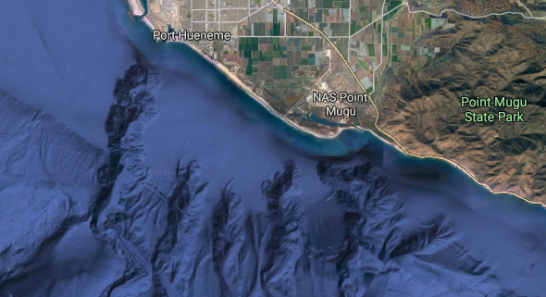
World in Ice Age last 3 million years
Each cycle consists of long periods of continental glaciers
With short periods of inter-glacial warming
Continental glaciers ties up so much water that sea levels can drop 400 feet – causes submarine canyons

Slide 18
World Ice Age
In inter-glacial (warming) cycle last 10,000 +/- years
Last glacial period ending (melting) caused rapid sea level rise
Example:
San Francisco area
Last 18,000 years

Slide 19
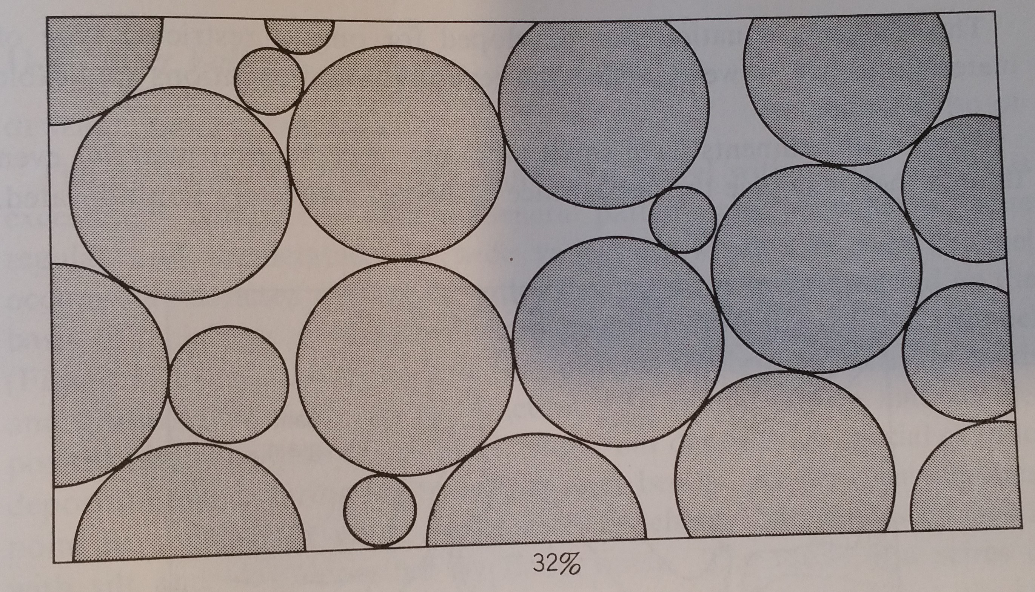
Groundwater - Very Simple Introduction
Groundwater exists in all rocks at depth
Water located in rock pore and fracture space
sand grain
Example of
32% porosity
Pore space
Fresh groundwater only located near surface,
where rain sourced water recharges groundwater to flush out salts
- At depth all groundwater contains dissolved chemicals

Slide 20
Ventura County Groundwater - Very Simple Introduction
Porosity usually decreases as unconsolidated sand is buried and consolidated into sandstone
At depth the sand is compacted and cemented
Santa Monica Mountains consists of consolidated rocks
Has little porosity to hold groundwater
Poor conditions for groundwater
So Simi Valley and Conejo Valley has little potential for groundwater aquifers

Slide 21
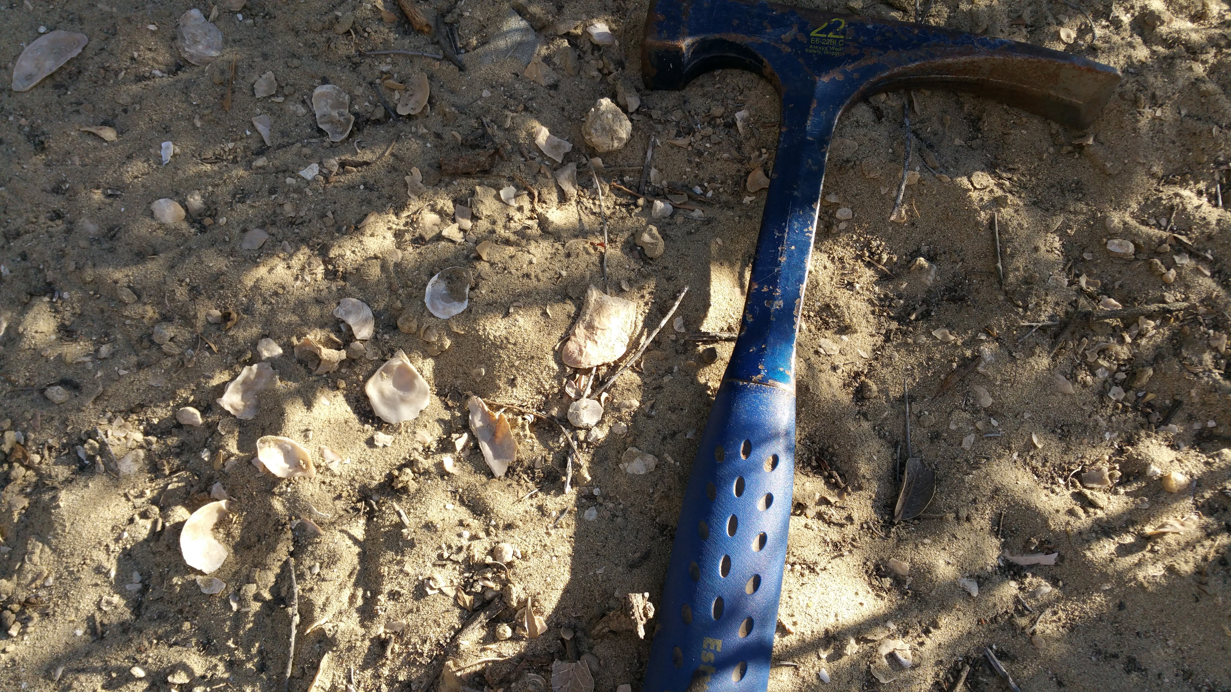
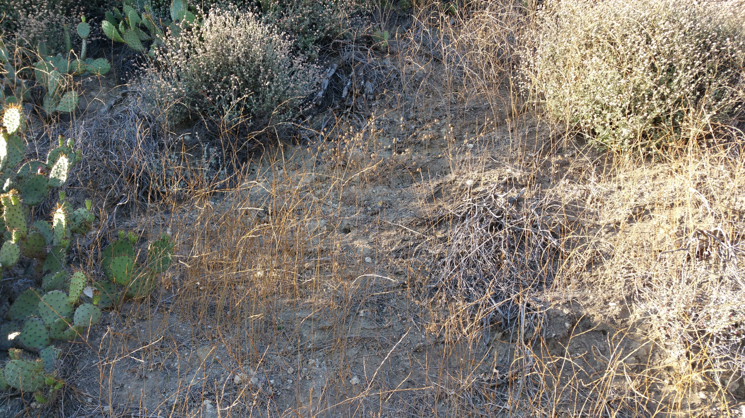
Ventura County Groundwater – Very Simple Introduction
West of Santa Monica Mountains
consist of younger unconsolidated sediments
Example – Las Posas Sand formation (shallow marine deposit)
Only about 1.5 mya – pictures from outcrop in ridge near Mission Oaks
under Oxnard plain the formation is called ‘Fox Canyon Aquifer’

Slide 22
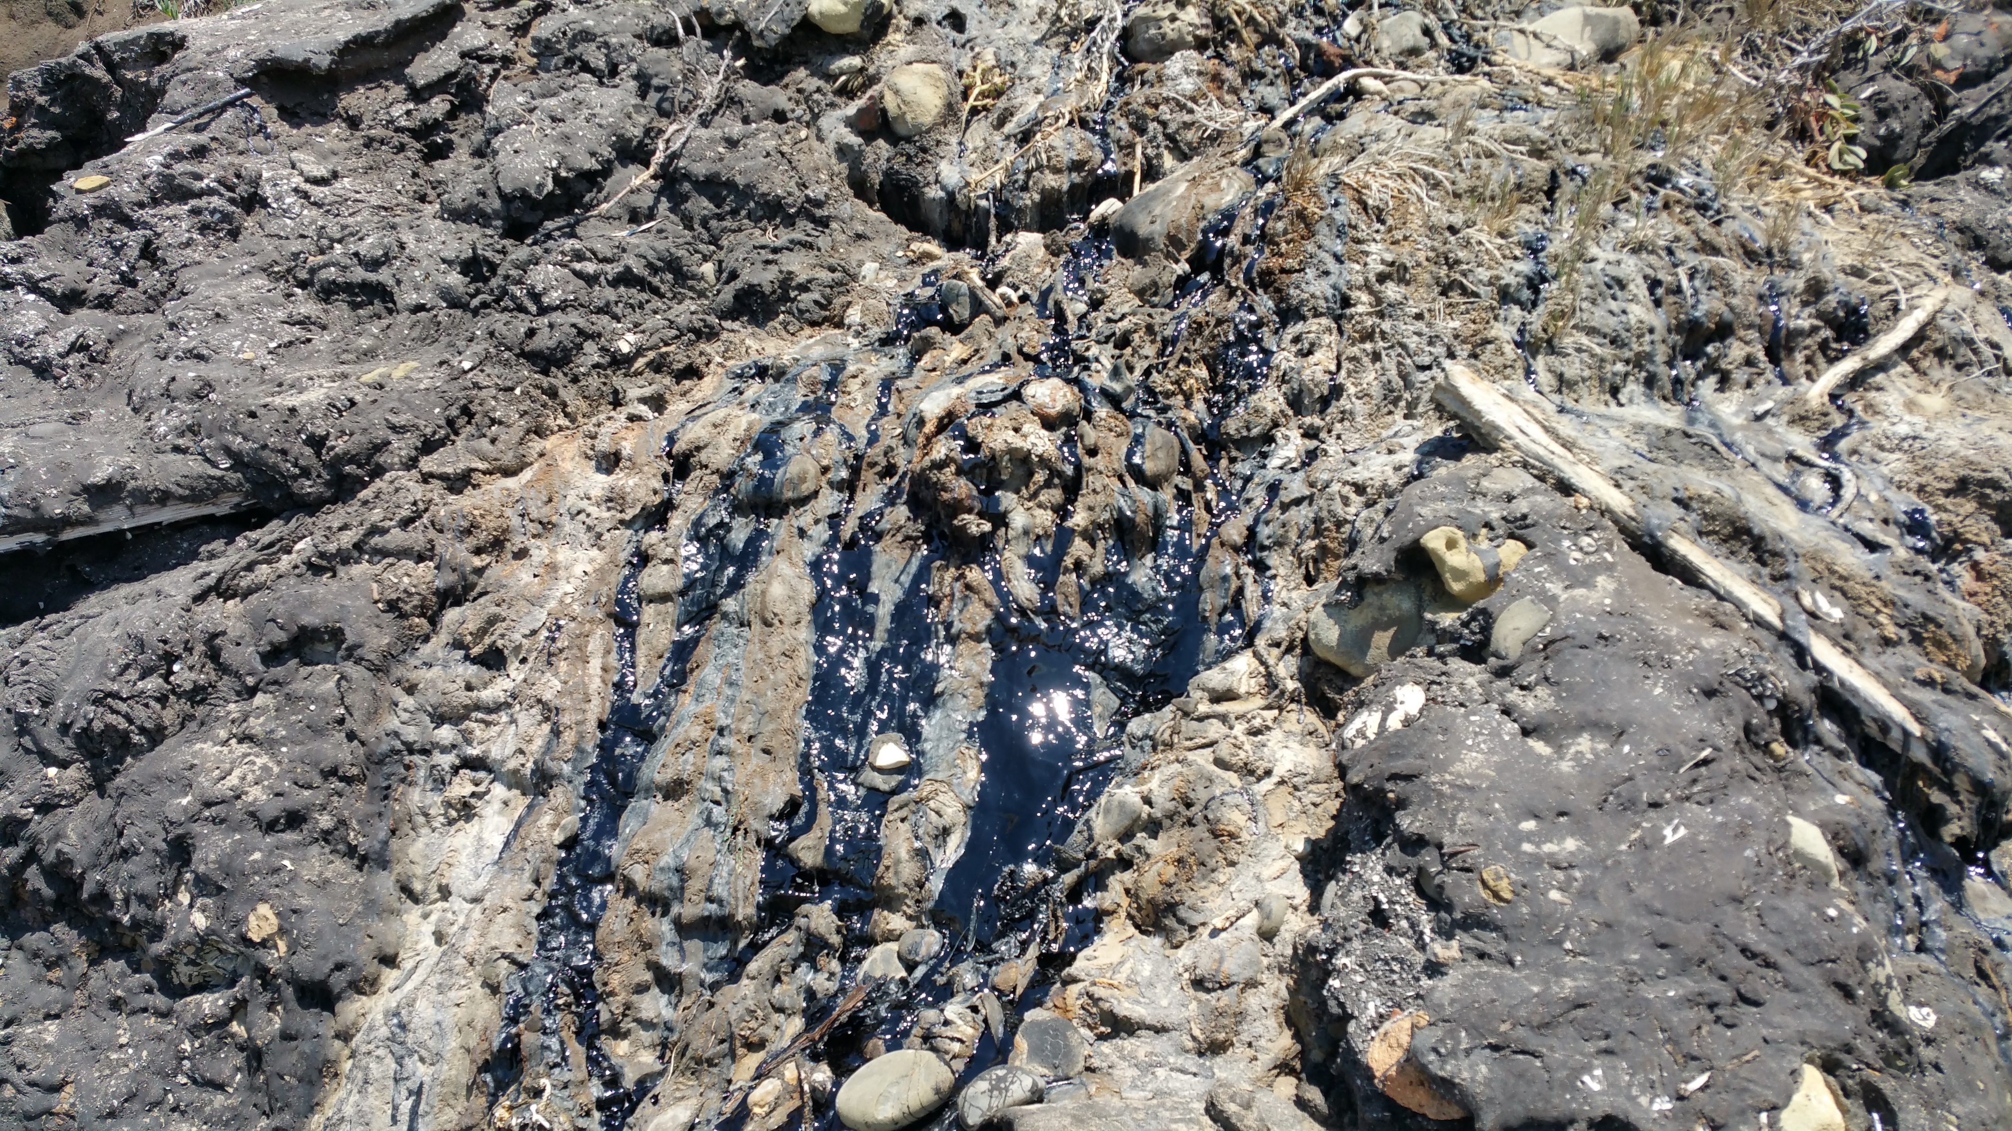
Ventura County Oil and Gas
Monterey Formation is source for most oil and gas
When buried deep enough with increasing heat will generate hydrocarbons
Hydrocarbons ‘float’ up thru groundwater
Unless ‘trapped’ they reach the surface
Oil seeps near
Carpinteria

Slide 23
Ventura County Oil and Gas
Methane gas seeps from sea floor off UCSB

Slide 24
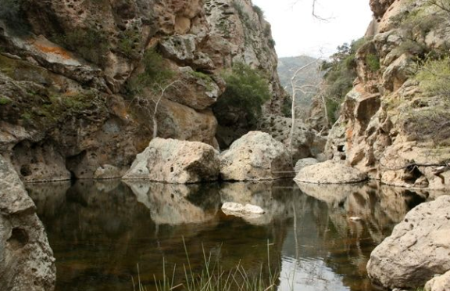
Ventura County Oil and Gas
Where Monterey Formation was never buried deep enough to generate hydrocarbons,
then Monterey Formation still contains the organic matter
Example: Headwaters of Malibu Creek erode the Monterey Formation releasing the organic matter as fertilizers into the creek

Slide 25
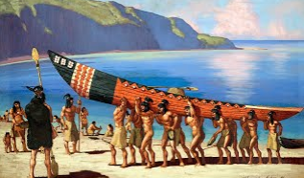
Ventura County Oil and Gas
Chumash Indians built their boats at Carpinteria
So Spanish named the local village after the carpenters building the boats
Chumash built boats there because of the tar from the local oil seeps

Slide 26
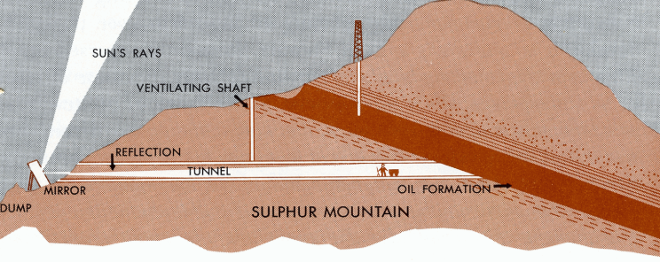
Ventura County Oil and Gas
Union Oil Company started in Ventura County
First oil ‘wells’ were tunnels to ‘drain’ oil from mtn

Slide 27
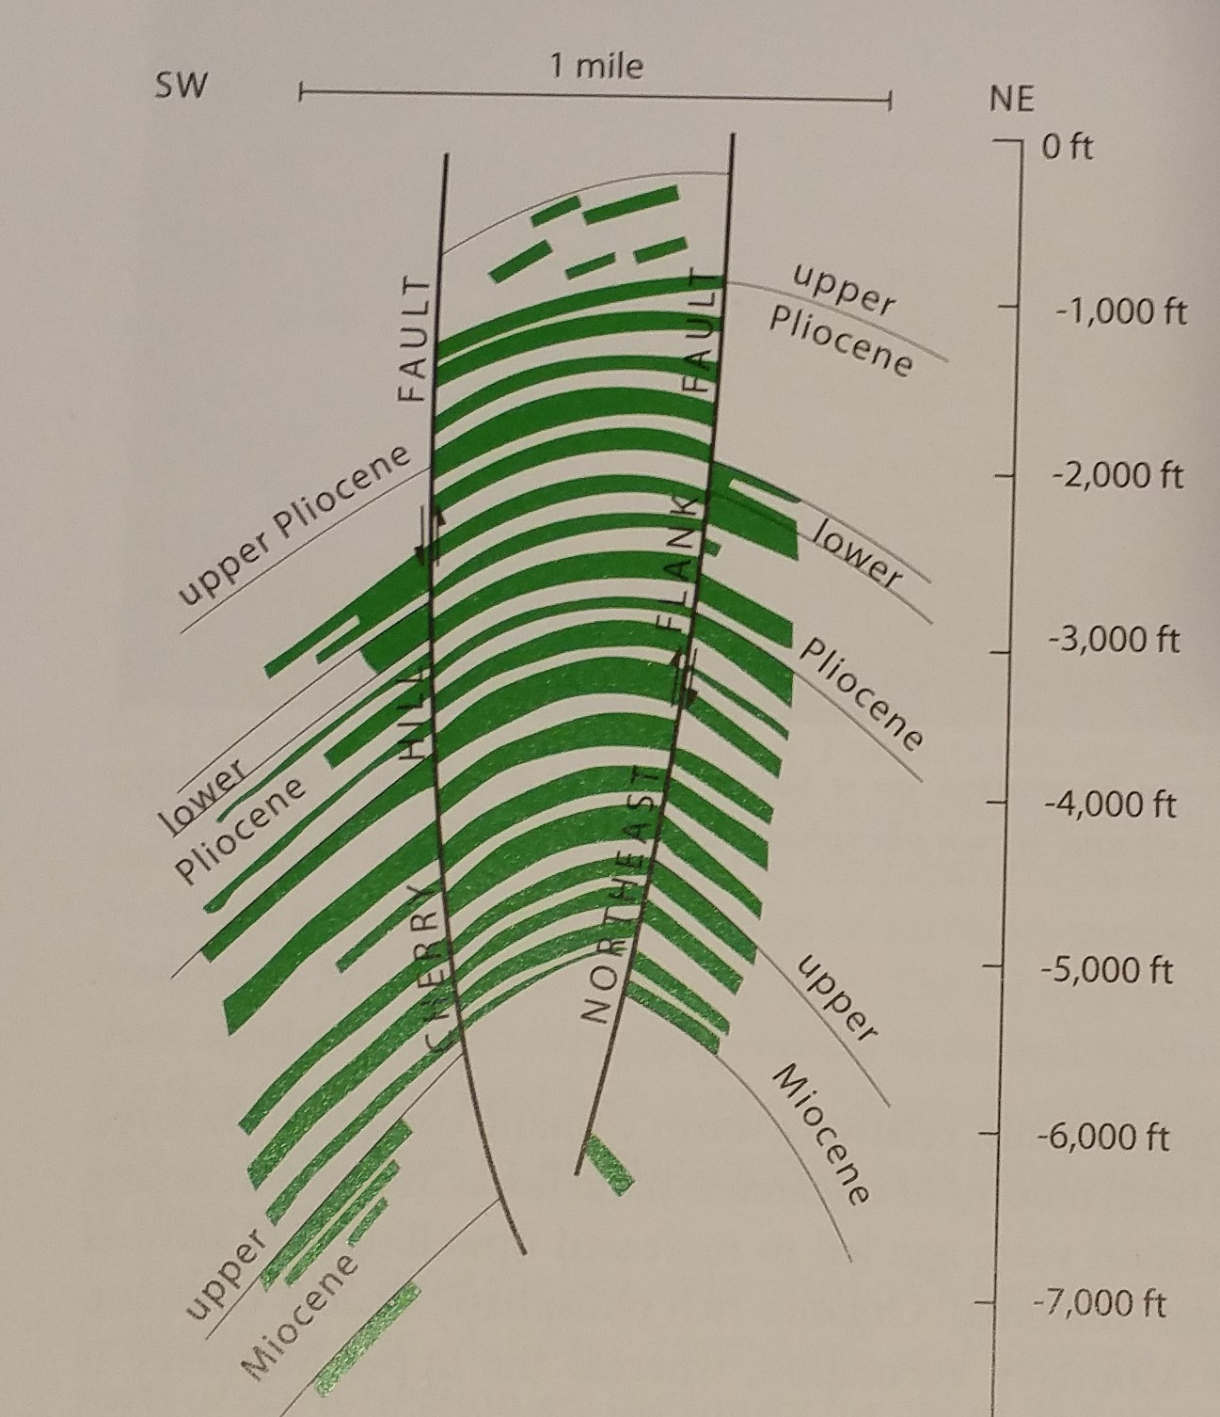
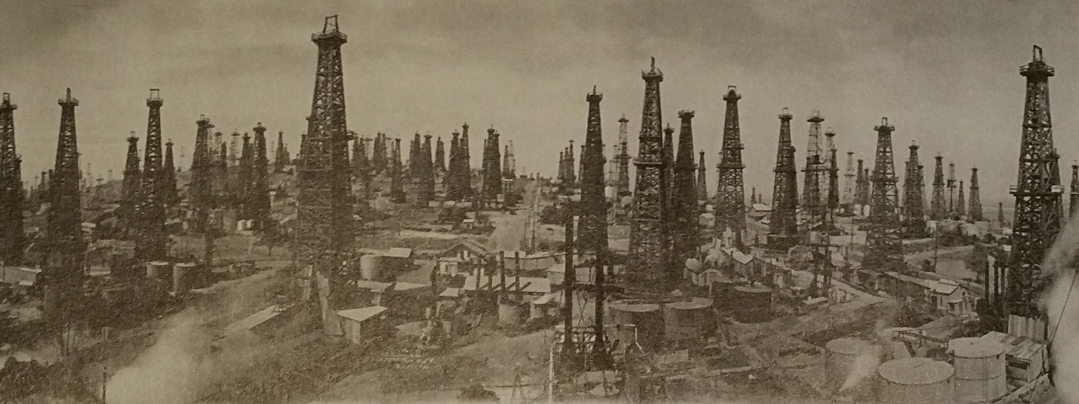
Ventura County Oil and Gas
Los Angeles Basin Oil fields
Produced most oil per acre in world
Reason: stacked oil fields
During 1920’s produced quarter of world oil supply
Long Beach oil field
Signal Hill field 1920’s

Slide 28
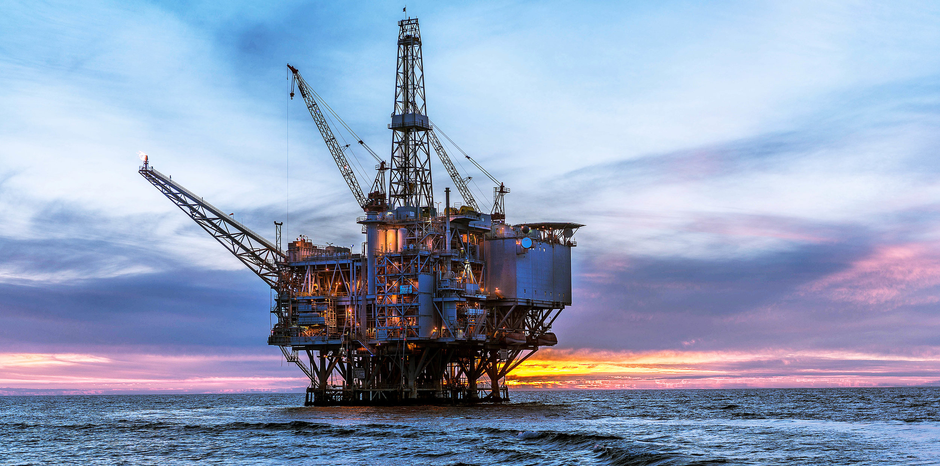
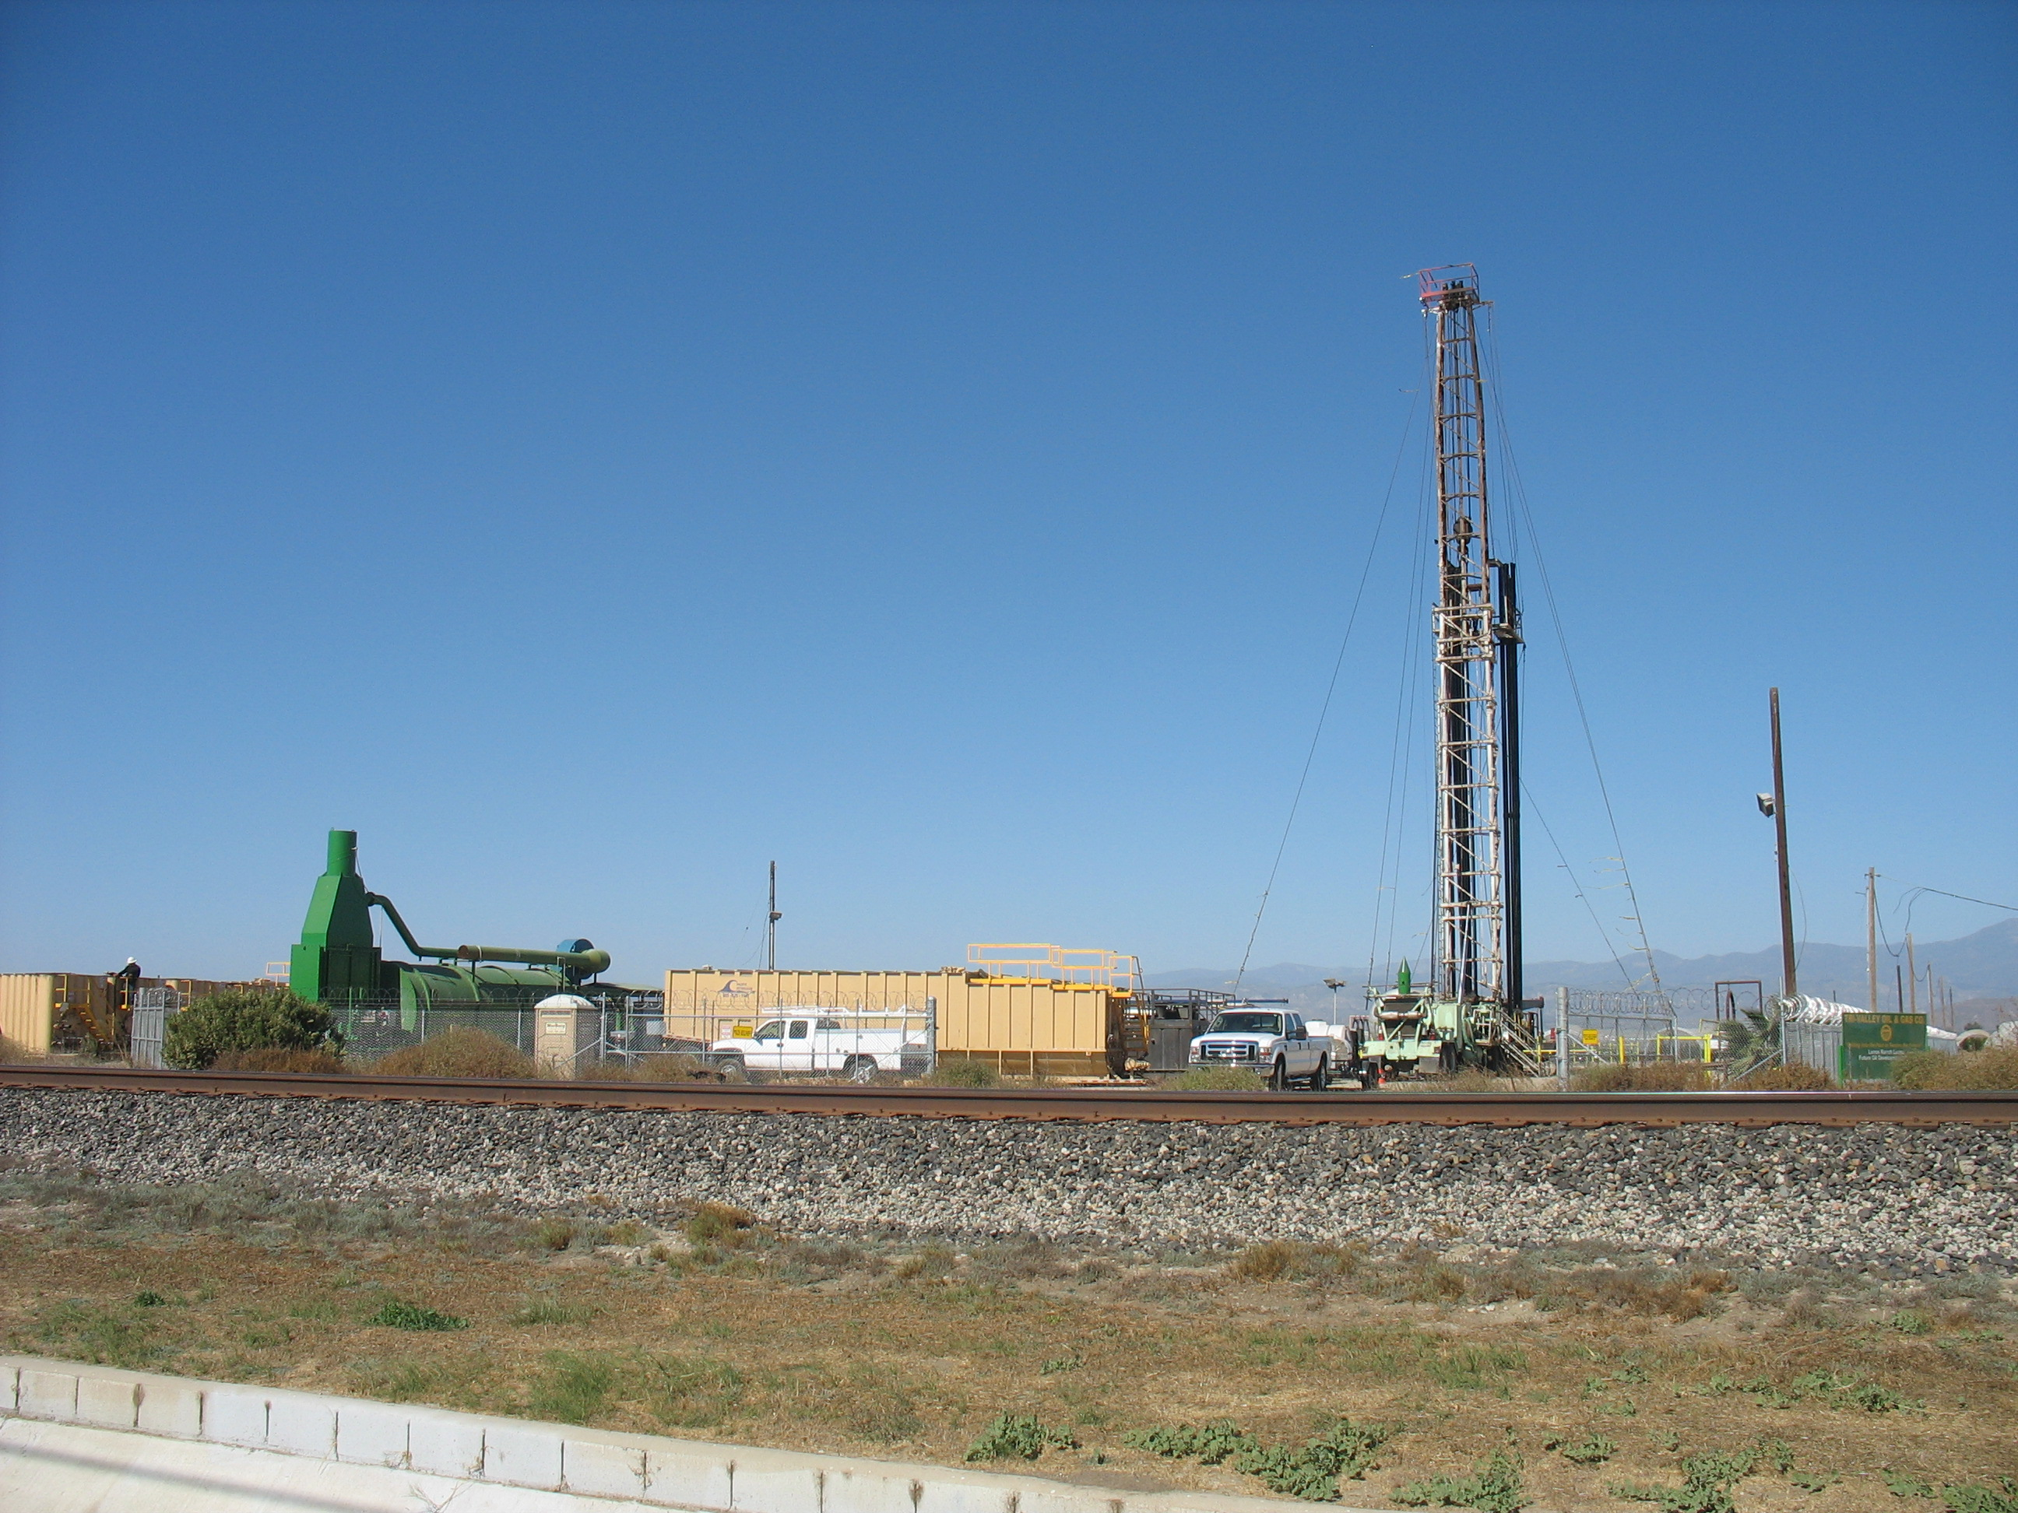
Ventura County Oil and Gas
Some interesting facts:
Monterey Formation is both a source rock and a reservoir (trap) under the right geologic conditions
Producing oil from offshore oil fields reduced oil seeps into Santa Barbara channel
Ventura Avenue oil wells have to be replaced as hill grows, which damages the older wells
Oxnard oil field contains the heaviest oil in U.S.
Inject stream to produce the heavy oil - heavy oil used to make aspalt
Conejo oil field (at Camarillo Springs) was shallowest oil field in U.S.

